Slide 1
Setup

Slide 2
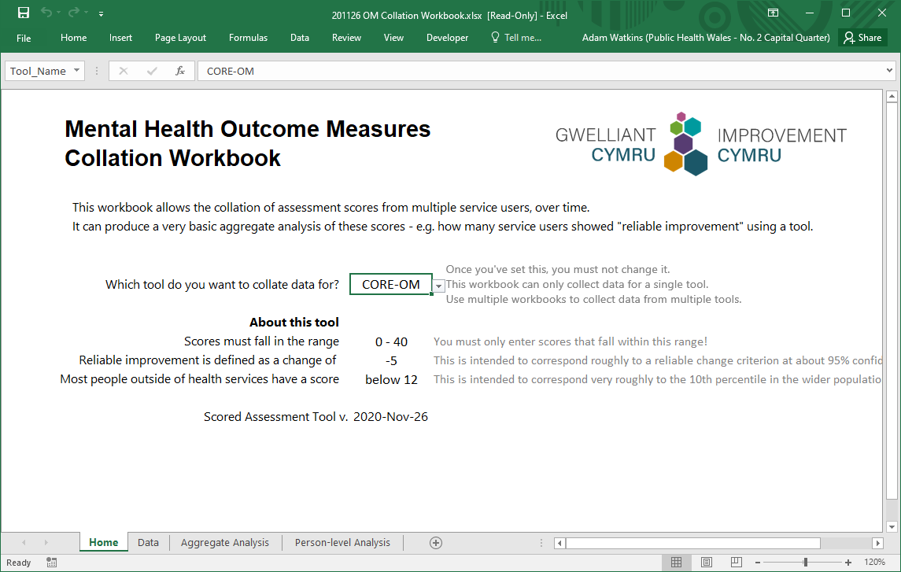
When you first open the workbook, it will open on the Home worksheet.
Home

Slide 3
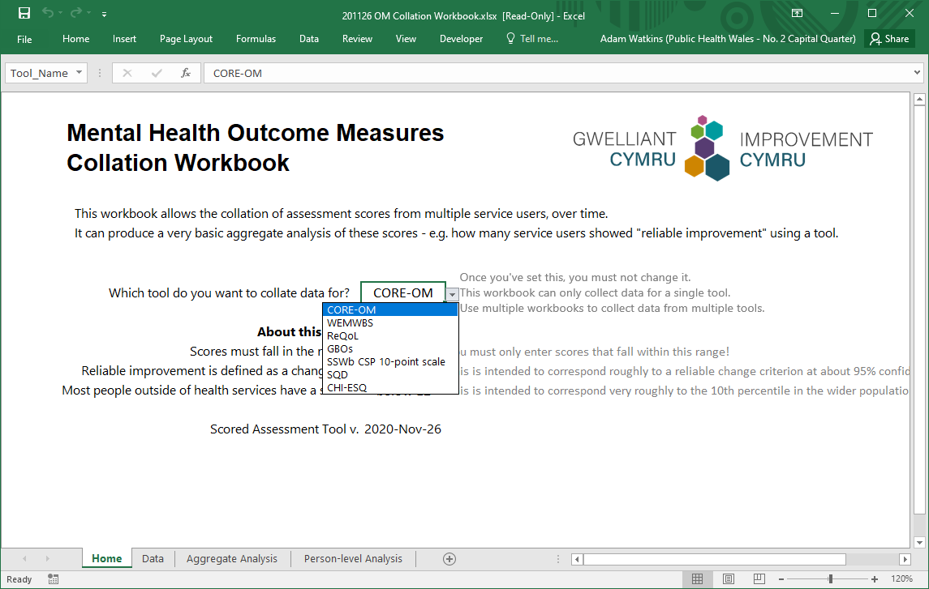
The first thing you have to do is pick the tool that you’re going to use.
Once you do this, and start entering data, you must not change it.
You’ll have to start a new workbook if you want to pick a different tool.
(CORE-OM covers
the 34-item version,
the CORE-10 and the YP-CORE.)
(WEMWBS covers both the full and the ‘Short’ version.)

Slide 4
Once you’ve picked a tool, the workbook gives you some information about:
What kind of scores it expects you to enter.
How it will interpret those scores.
I’ve picked CORE-OM, and you can see that it expects scores between 0 and 40.
We’ll come back to the other information (‘Reliable improvement…’) later on.

Slide 5
Saving

Slide 6
Once you’ve selected the tool that you’re going use, you’ll need to make sure you Save the workbook for the first time.
You’ll need to agree with your team where you’ll keep this workbook. You should probably keep it on a shared network drive, where all and only your team members can access it.
If you need advice about where to keep the workbook, you should talk to your local IT department.

Slide 7
File
To save the workbook for the first time, click on the File menu in the top left.

Slide 8
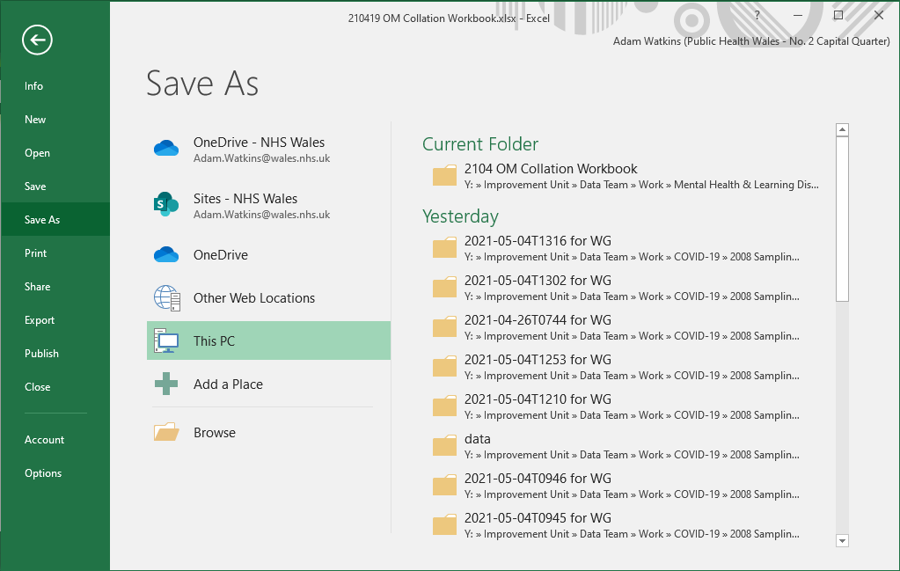
To save the workbook for the first time, click on the File menu in the top left.
Then click on the Save As option.
Save As

Slide 9
To save the workbook for the first time, click on the File menu in the top left.
Then click on the Save As option.
Then click on the Browse option.

Slide 10
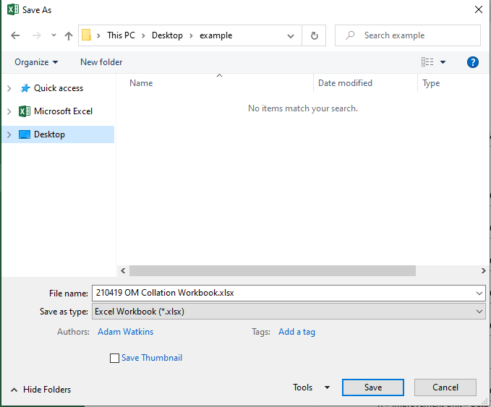
To save the workbook for the first time, click on the File menu in the top left.
Then click on the Save As option.
Then click on the Browse option.
This will open a save dialog box.
Here you can navigate to where you want to save the workbook, and rename it. For more help with this, talk to your local IT department.

Slide 11
You might want to change the filename of your workbook so that it includes:
  When you started it - e.g. ‘2021-05-01’
  What your team is called – e.g. ‘Llareggub CMHT’
  Which tool’s score you’re recording – e.g. ‘CORE-OM Scores’
2021-05-01 Llareggub CMHT CORE-OM scores.xlsx

Slide 12
Data Entry

Slide 13
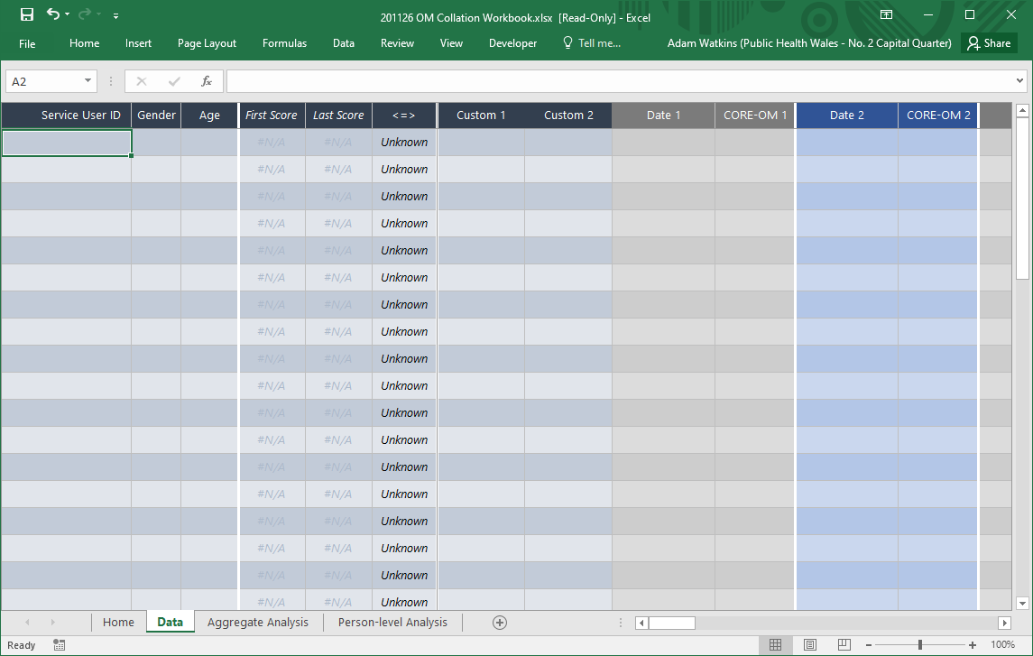
Click on the Data tab, to move to the data entry worksheet.
This is where you will enter information on service users and their scores.
Data

Slide 14
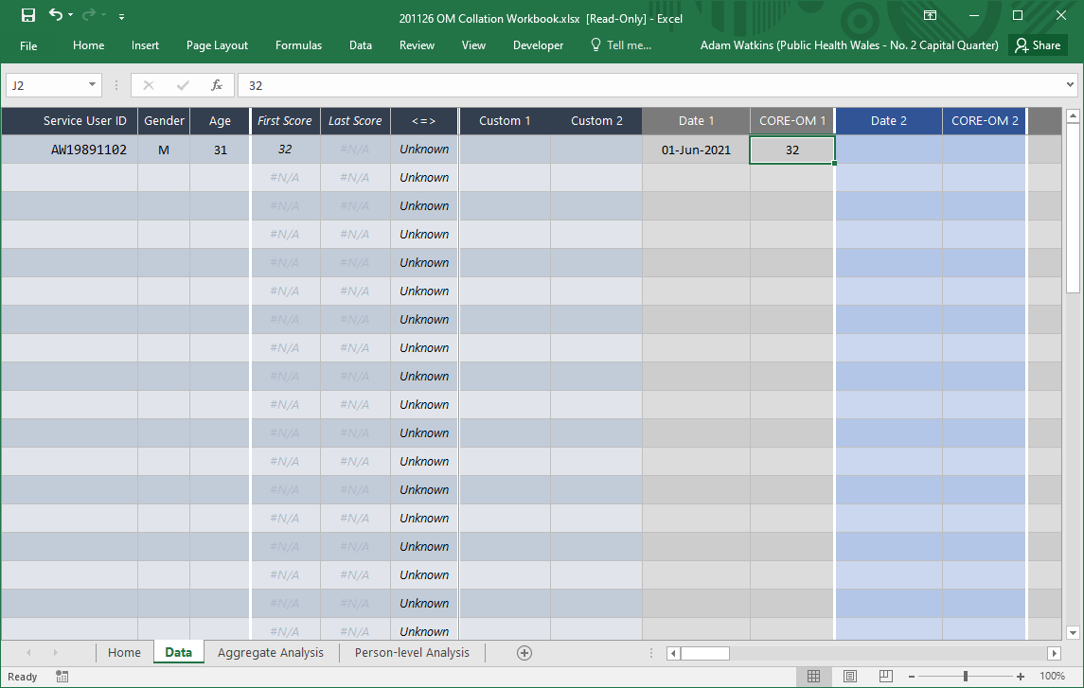
You and your team
will have to decide what you will use to identify service users in the
Service User ID column.
It should be something unique for an individual and easily searched for.
If you have ‘CRNs’ or ‘Hospital Numbers’ for your service users, they might be a good choice. (These also allow you to share the workbook more safely - compared with names, for example.)
For Gender, I suggest you generally enter:
‘M’ (for male or men)
‘F’ (for female or women)
(You might also want to use ‘N’ for non-binary and ‘U’ for unknown.)
For Age, I suggest you generally enter a whole-number of years, based on how old the service user was at the start of the intervention.

Slide 15
These three columns:
First Score,
Last Score, and
<=>
are automatically calculated based on the data you enter on the rest of this sheet,.
You should not edit these!
These are shown in italics in the spreadsheet.
These columns provide a quick view of the earliest and latest scores for a record.
The <=> column summarises the difference between the two.

Slide 16
The final pairs of columns are for entering:
When a score was collected.
What that score was.
When you enter dates, you should enter them as ‘31/6/2021’
(e.g. for 31st June 2021).
Make sure that you’re entering the right score for the tool
you’ve selected.
For example, this workbook now expects a score between 0 and 40 for CORE-OM tools.
(You can see the selected tool is shown in the column names,
e.g CORE-OM 1.)

Slide 17
The two Custom columns are for your team to use as they wish.
They’re particularly useful if you want to compare outcomes between different sets of service users.
For example, you might use one of the columns to capture ‘Intervention’.
We’ll look at this when come to ‘Aggregate Analysis’ of the data.

Slide 18
Whenever you enter new data in to the workbook, you should Save it.
You can do this by either:
Clicking on the disk icon in the very-top-left of the window, or
Pressing the Ctrl + S keys on your keyboard at the same time.

Slide 19
Person-level Analysis

Slide 20
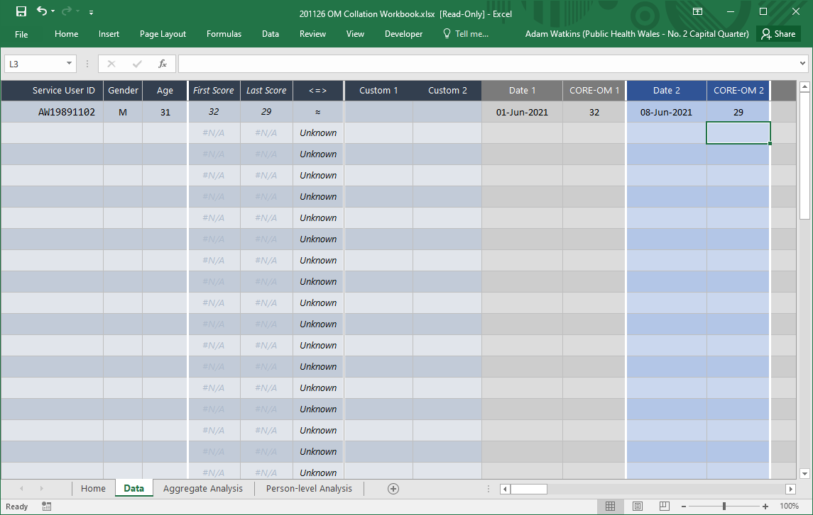
Here, I’m adding a second, later score for
this service user, in the Date 2 and CORE-OM 2 columns.

Slide 21
Note that the First and Last Score columns automatically update.
The <=> column interprets the change between the two scores.
This service user’s score has reduced from 32 to 29.
For the CORE-OM, a lower score generally means that the person is experiencing less distress.

Slide 22
This service user’s score has reduced from 32 to 29.
However, the <=> column is showing ≈ (a squiggly equals-sign).
That symbol - ≈ - means that there is no reliable change.
What do we mean by ‘reliable’ ?
The scores produced by outcome measurement tools are
not a 100% perfect measure of wellbeing or distress or whatever they are trying to measure.
People’s responses, and the scores generated from those responses, are affected by other things.
For example, thinking about the CORE-OM as a measure of distress over the last week:
Your mood this morning will probably affect how you answer questions about the last week.
You might happen to have undeniably achieved something last week (and so answer one of the questions more positively), but this might not significantly change your sense of helplessness to achieve things in general.
Going up or down by one point or two might not, therefore, accurately reflect a reliable change in someone’s level of distress – even if that change of a couple of points is important to that person and important to discuss.

Slide 23
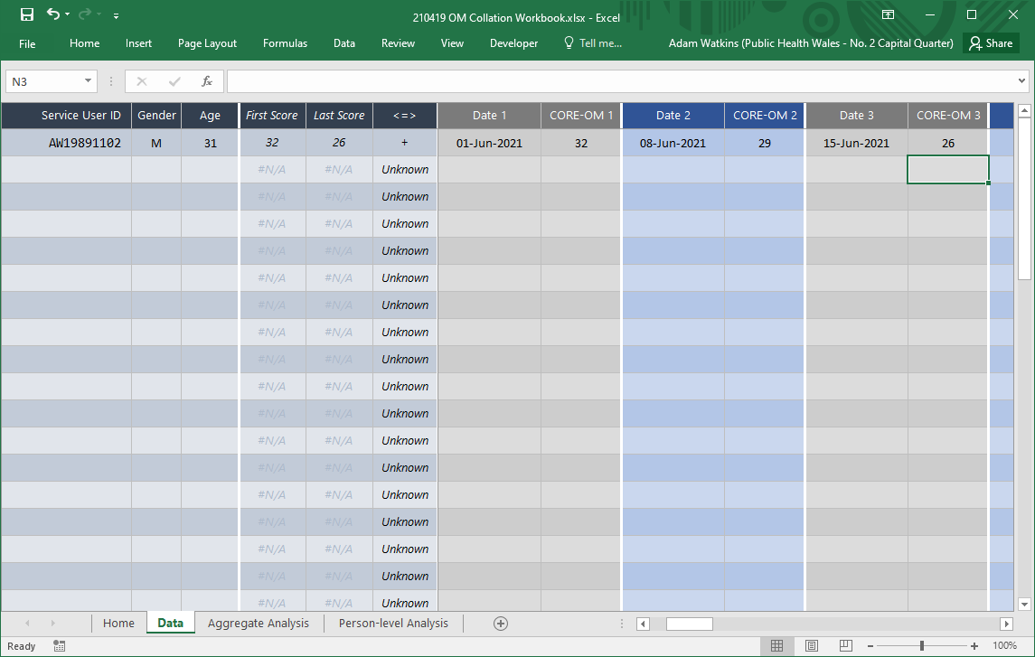
If we add a third score, of 26, the symbol in the <=> column,
changes to a + (a plus-sign).
This means that the difference between the First and Last Score is now considered to show reliable improvement.
For the CORE-OM, we have decided that a change in score of 5 or more points is unlikely to occur without a change in the service user’s distress, and therefore can be considered reliable.
Other tools have different requirements for reliable improvement. For example, for the WEMWBS, we’ve decided that a change of 6 or more points is considered reliable.
Where possible, we’ve looked at what the authors of the tools say we should use. It can be tricky to decide what to use, because tools might be slightly more or less reliable in different situations or with people from different backgrounds.
We’re happy to discuss this with individual teams.

Slide 24
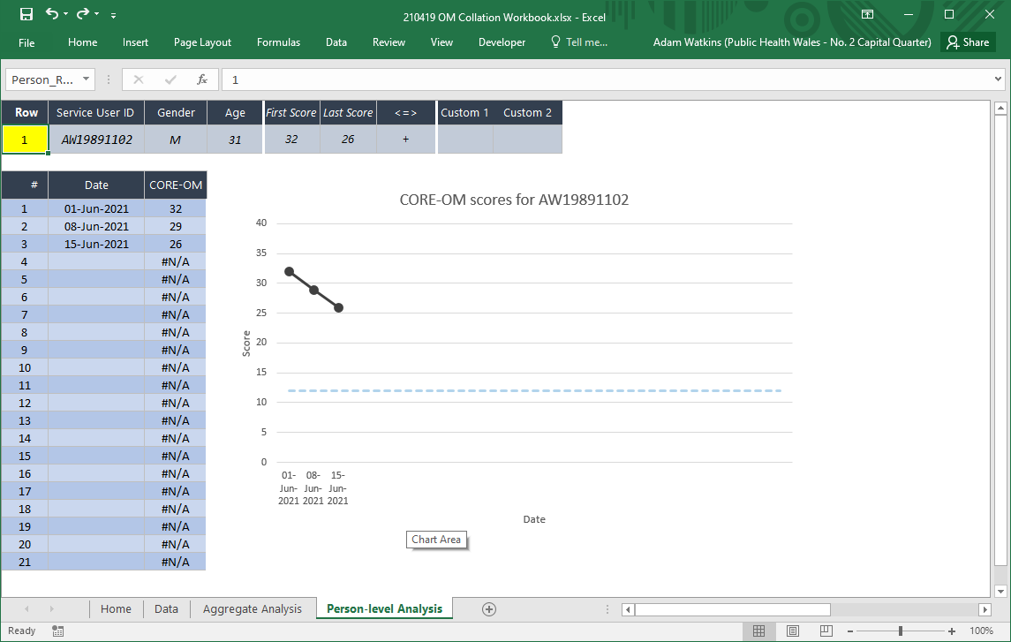
Click on the Person-level analysis tab.
This will let you see an individual’s scores over time.
Person-level Analysis

Slide 25
Change the Row field to view different service user’s scores.
AW19891102 is the first service user in the Data sheet so Row ‘1’ shows their scores.

Slide 26
You can see the three scores entered for this service user.
You can easily see the positive trajectory – scores reducing over time – over these three weeks.
The workbook can cope with up to 21 scores for an individual.
(You will need to start in a new row in the Data tab if you end up with more than 21 scores.)

Slide 27
The chart also shows a dotted-blue line.
This gives a rough idea of what sort of scores are found in the wider population outside of health services.
For example, we’d expect most people outside of health services to score 12 or less on the CORE-OM.
This is similar to the ‘clinical cut-off’ that might be defined for some tools, but almost always less strict. (For example, the clinical cut-off for the CORE-OM is generally defined as 10.)
Again, it can be tricky to decide where we draw this line for different tools and we’re happy to discuss this in more detail.

Slide 28
Note that the values used for defining reliable improvement and drawing a wider-population guideline are shown on the Home sheet when you pick a tool for the workbook.

Slide 29
Aggregate Analysis

Slide 30
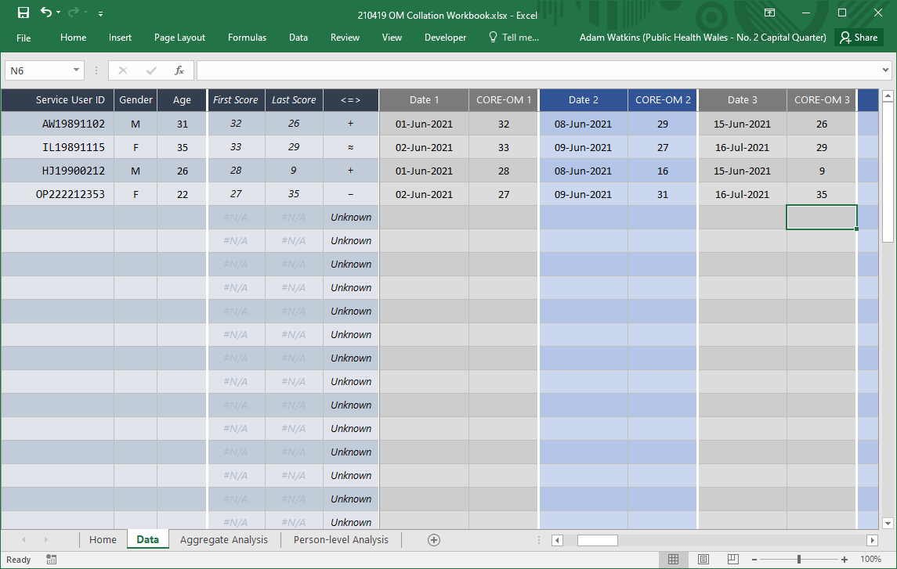
I’ve gone back to the Data tab and added data for three more service users.
For each service user, I’ve added three scores.

Slide 31
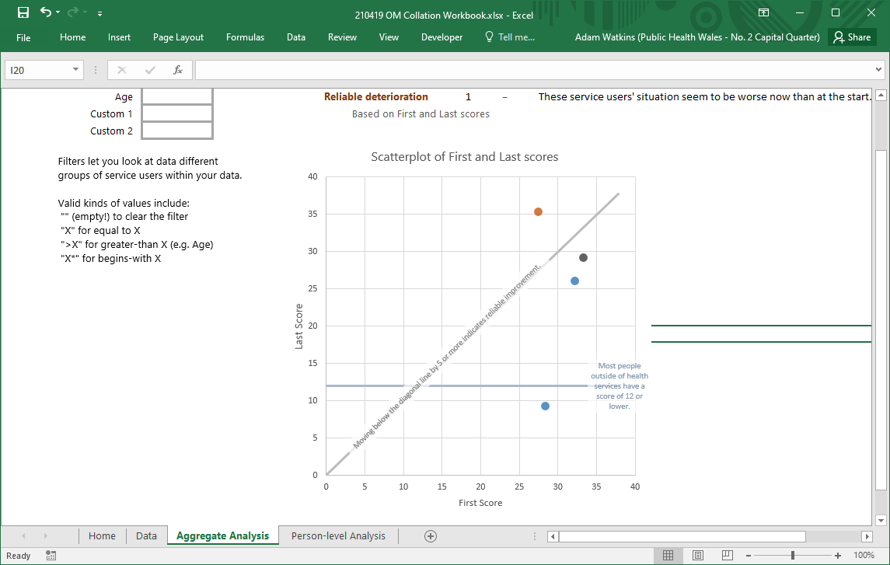
Click on the Aggregate Analysis tab.
This lets us look at the overall pattern of change in service users’ scores.
Aggregate Analysis

Slide 32
You can see that the chart opposite shows four dots.
Each dot represents a service user with at least two scores.

Slide 33
The colour of the dot shows whether or not the service users’ scores indicate reliable change.
Blue dots represent service users whose scores show reliable improvement. (There are two of these on the chart.)
Grey dots shows service users whose scores don’t show any reliable change.
Orange dots show service users whose scores show reliable deterioration. (There is one of these on the chart.)
As you collect and enter data for more service users, a pattern will emerge.
This pattern usually shows a large number of blue dots – many people will improve during their time with health care services – but also a number of grey and orange dots.
The blue dots are important as one way to show the positive impact of a service.
But the grey and orange dots are perhaps even more important because they might indicate that the service needs to work differently for some people.

Slide 34
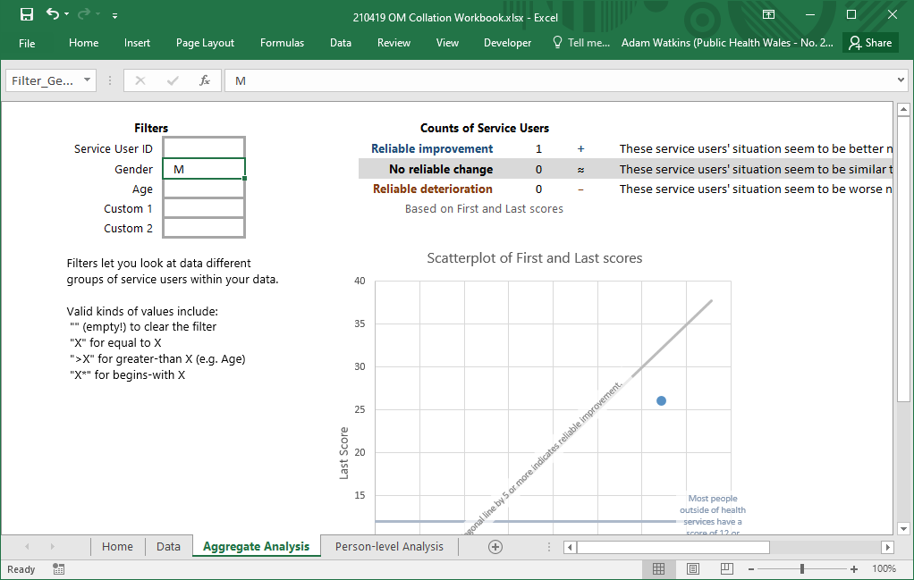
You can filter the service users shown on the Aggregate Analysis sheet by using the cells in the top left of the sheet.
For example, by entering “M” into the Gender box, you can show only those Service Users that you assigned a Gender of “M” on the Data sheet.
This lets you compare the earliest and latest scores for different groups.
Note, in particular, that you can filter by the Custom 1 and Custom 2 columns – which might be useful if you want to compare different interventions, for example.

