Slide 1
Mortality of
People with a Learning Disability in Wales, 2012-2022

Slide 2
Identifying
People with a
Learning Disability

Slide 3
Identifying people from hospital records
Person goes into hospital
  For example, for some work on their teeth

Slide 4
Identifying people from hospital records
Person goes into hospital
  For example, for some work on their teeth
Doctor writes “This person has a learning disability”
in their clinical notes for this person

Slide 5
Identifying people from hospital records
Person goes into hospital
  For example, for some work on their teeth
Doctor writes “This person has a learning disability”
in their clinical notes for this person
I search through clinical notes for the last 10 years
for “learning disability” to find people
  Or “Downs syndrome” etc.

Slide 6
People with a Learning Disability
9500 – 16,000 people
identified for each year
Notes:
Overlaps but different from:
15,000 people on GP LD registers
60,000 people with a learning disability
People known to LD specialist services
Different to LeDeR in England, Scottish analyses
Diagnoses found in the ‘Admitted Patient Care Data set’ (APC Ds). This is roughly equivalent to ‘PEDW’
LeDeR works backwards from reported deaths
Scotland has access to other data sources
Only looked at people aged 4 and over, similar to LeDeR

Slide 7
People with a Learning Disability
Notes:
Each year after 2012, about 5-8% of the people are ‘newly discovered’ that year (i.e. they had a hospital admission and a coded diagnoses was recorded for the first time)

Slide 8
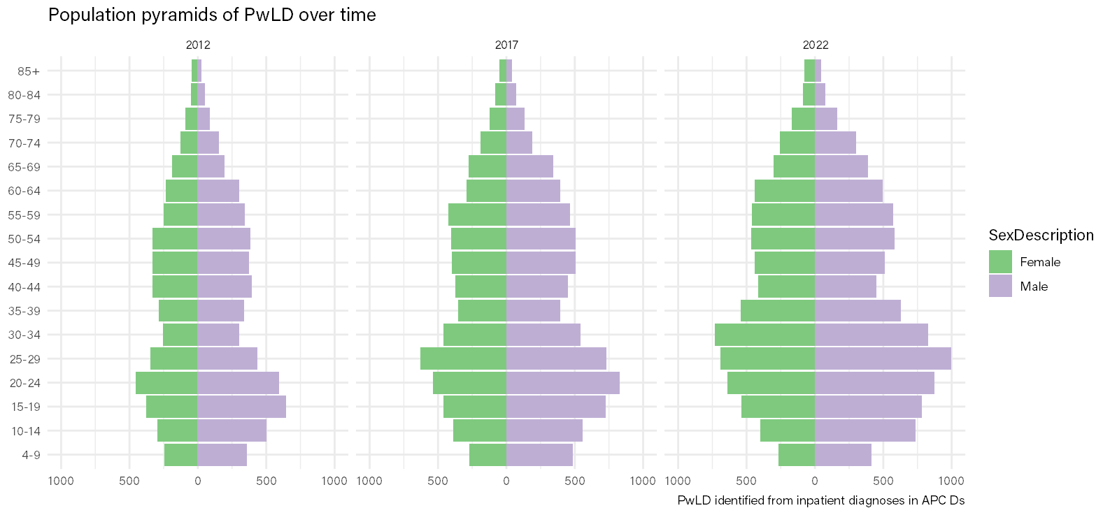
People with a Learning Disability
Notes:
People with learning disabilities

Slide 9
Deaths of People with a Learning Disability
3299 deaths between 2012 and 2022

Slide 10
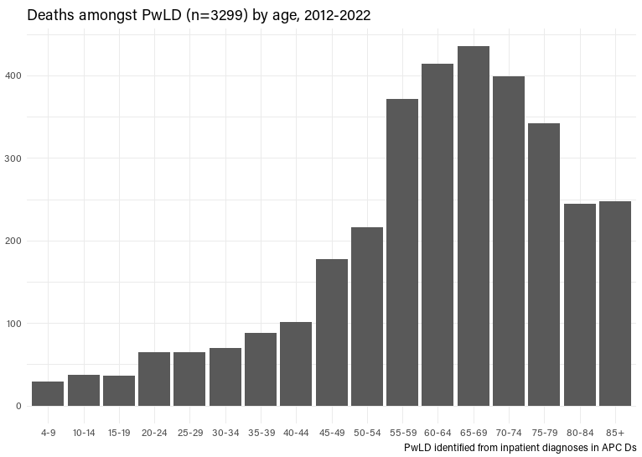
Age at death
Notes:
Very roughly similar to LeDeR and Scottish findings, despite difference in method

Slide 11
Age at death
Half of people
die at or before
65 years old
(vs 83 in wider pop.)
Most common
age at death
67 years old
(vs 87 in wider pop.)
Notes:
Very roughly similar to LeDeR and Scottish findings, despite difference in method

Slide 12
Underlying causes of death

Slide 13
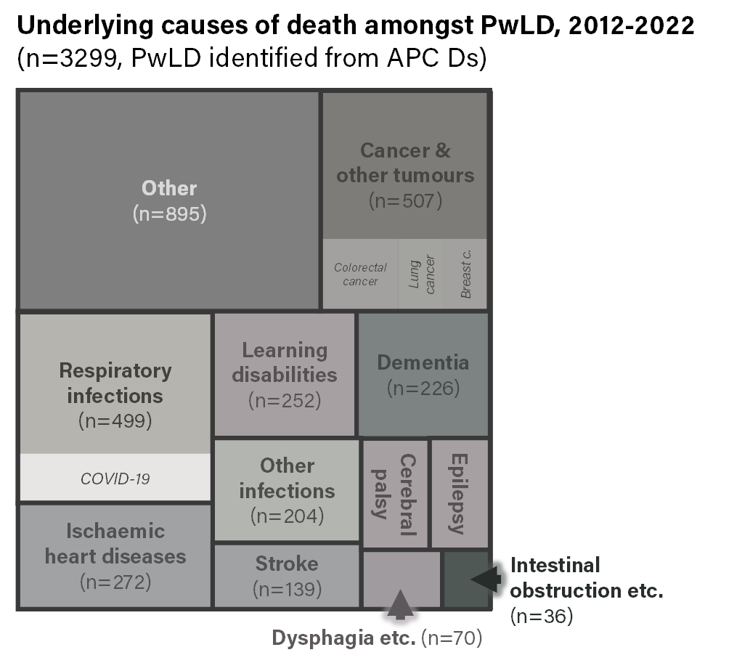
Underlying causes of death
Infections to do with
breathing caused
15 in 100 deaths
Cancer caused
15 in 100 deaths
Heart disease and
stroke caused
12 in 100 deaths
Dementia caused
7 in 100 deaths

Slide 14
Underlying causes of death
Roughly 40% of the underlying causes of death are ‘avoidable’
(vs around 20% in wider pop.)
Notes:
This is based on what ONS determines based on the death certificate, groupings are our own.
‘Other’ broken down in an appendix.
Underlying cause of death can mask causes of death that are more relevant to safety – people dying ‘of’ Down’s syndrome often have a causal route to death involving e.g. respiratory infections

Slide 15
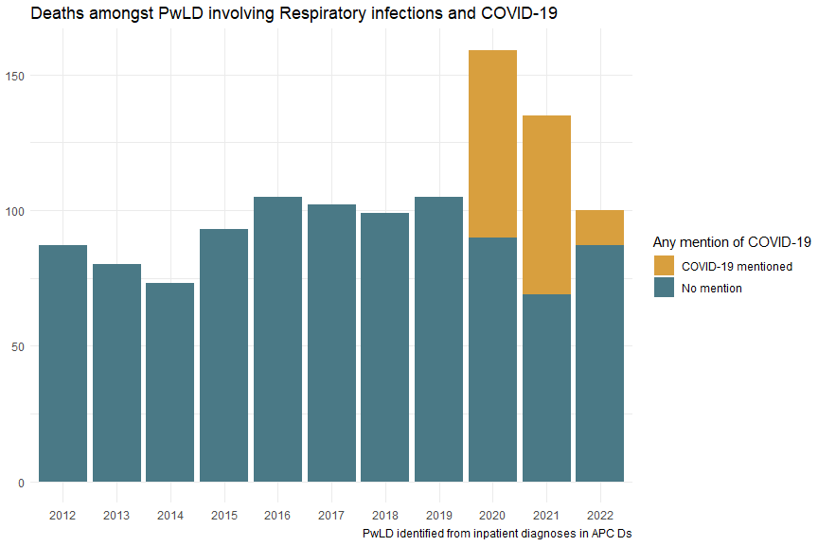
Respiratory infections
Notes:
Earlier work estimated mortality rate from COVID-19 in the people identified as 3x-6x higher than wider population
Some respiratory deaths from other causes displaced by COVID-19
Relevance to:
- Vaccination
- Early identification of illness
- Early identification of deterioration
Communication and cognitive impairment?

Slide 16
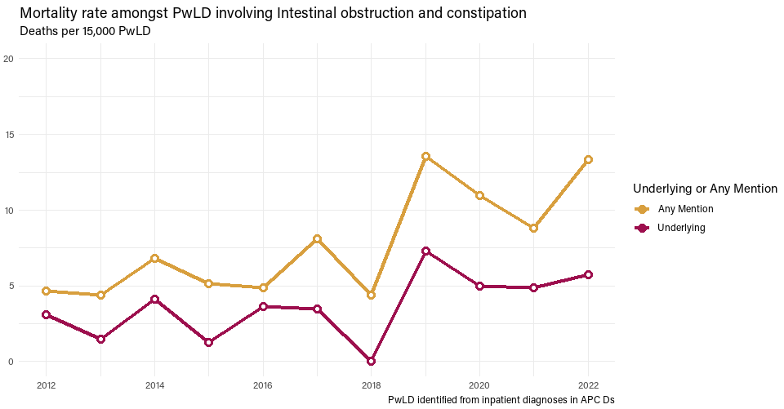
Intestinal obstruction
Notes:
Unclear if any apparent change is meaningful – but clearly not a decrease

Slide 17
Unknowns and
Next Steps
Notes:
Warning – ask at the end of this section

Slide 18
Unknowns and Next Steps
Medical Examiners Service (MES) dataset
Local variation in mortality
Healthcare activity
  A&E attendances, admissions
Impact of Acute Liaison Nursing (ALN) teams
  Describing ALN activity
Impact of Annual Health Checks
  Existing research

